Slide 1


Wales
CULTURE SPOT

Slide 2
Solve the riddle.
Am I a part of Great Britain?
The answer to that question is: yes
My capital is called Cardiff
I have a red dragon and flocks of sheep
The answer is: WALES
Watch an educational video about Wales.

Slide 3


Slide 4
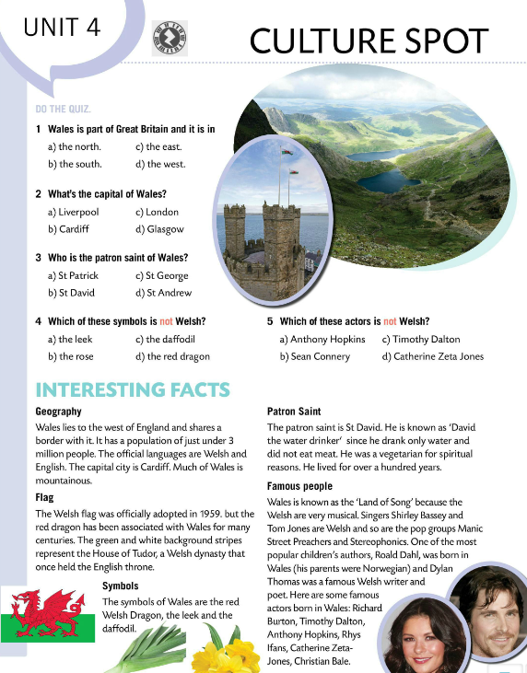
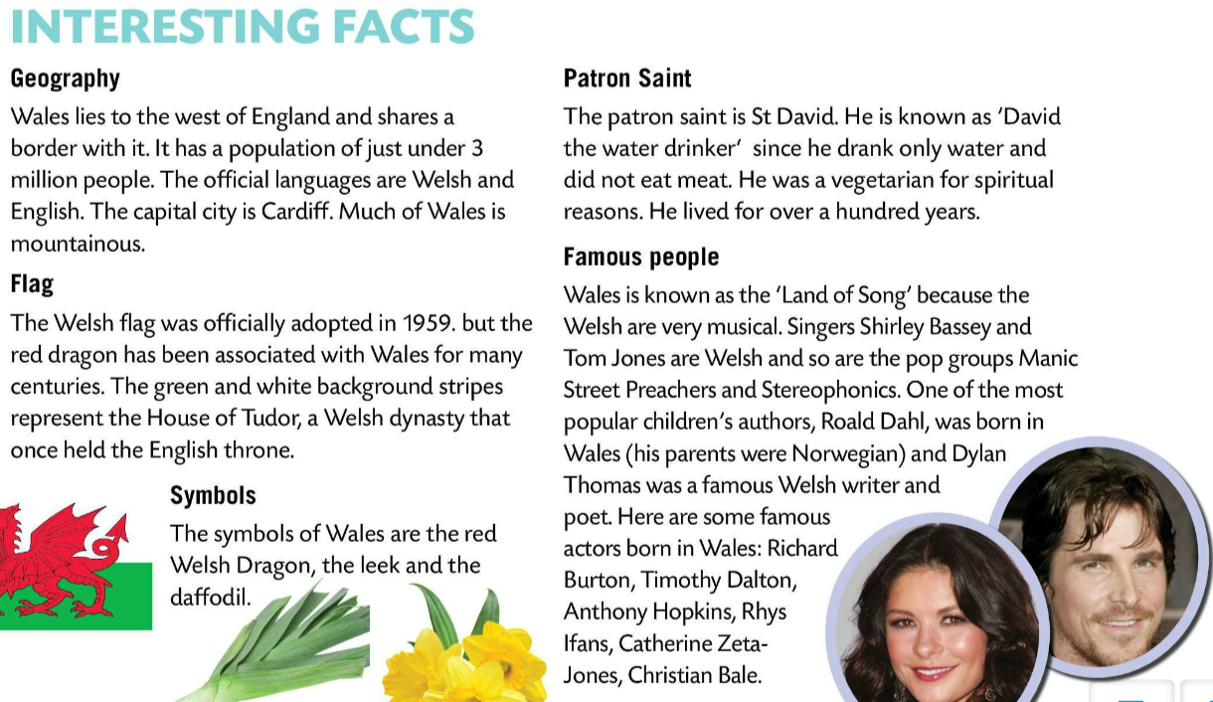
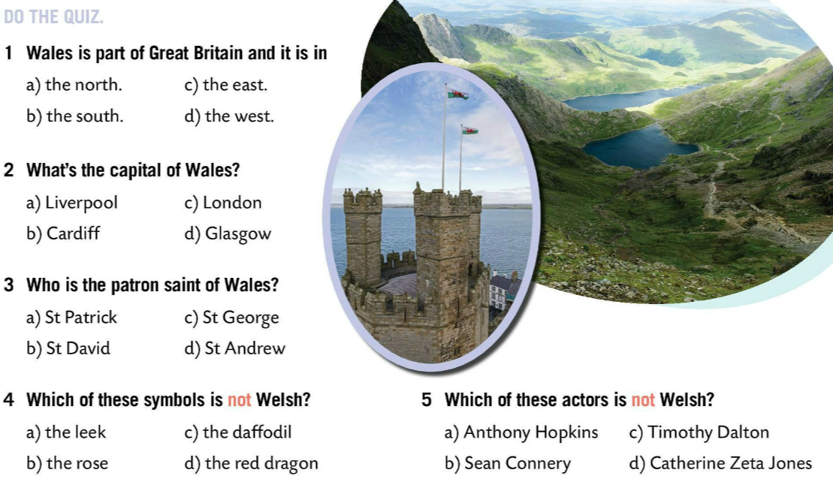
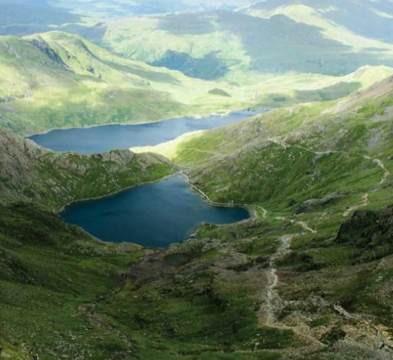
Do the quiz and check your answers in the text.
Read the text.
Let’s check!
Write five sentences about Wales in your notebook.

Slide 5
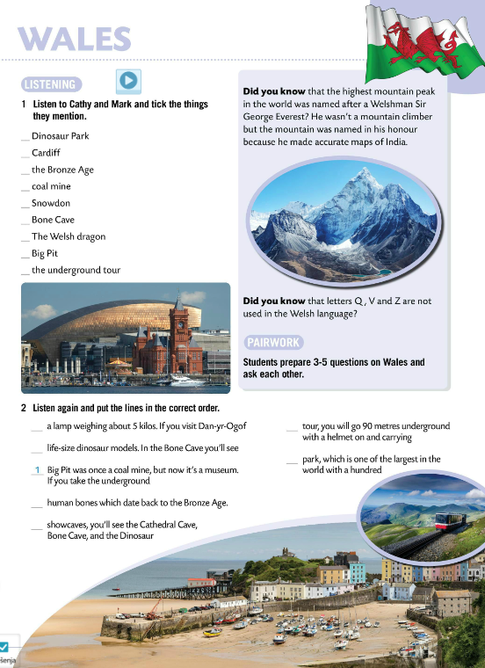
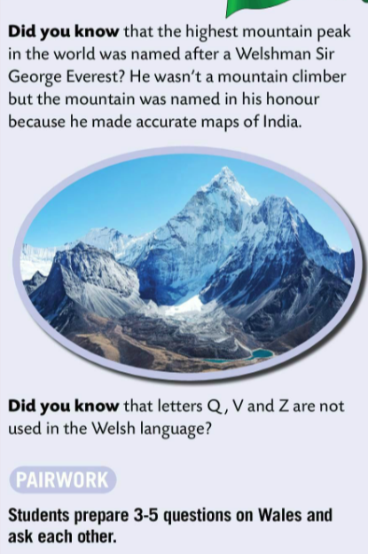
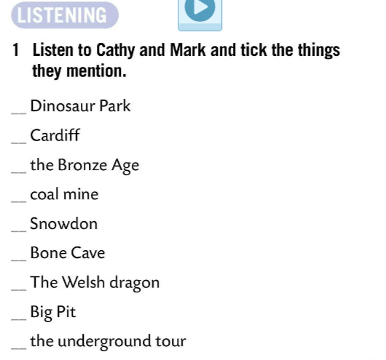

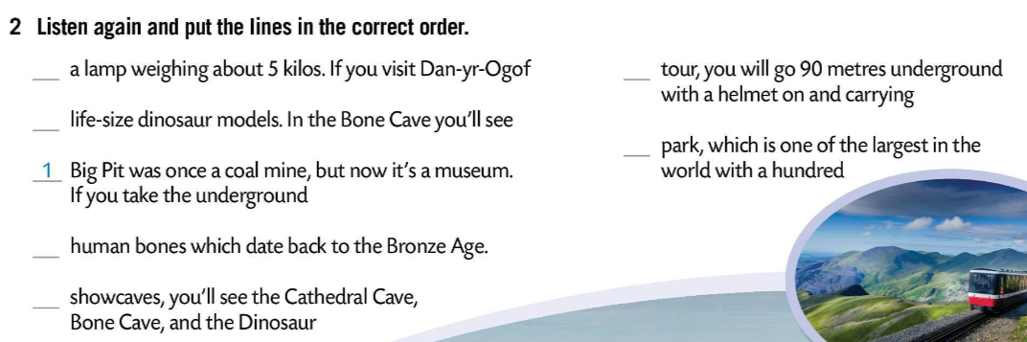

Read the text in pairs and prepare 3 – 5 questions on Wales. Ask each other these questions.
Listen to Cathy and Mark. Tick the things they mention.
3
2
6
Check.
5
7
4
Listen again and put the lines in the correct order.
Check.

Slide 6

Play this quiz and see how much you know about Wales. https://wordwall.net/play/854/002/812
Make a poster. Include key details about Wales. You can add drawings to make the poster more colourful. Enjoy! ☺

